Slide 1
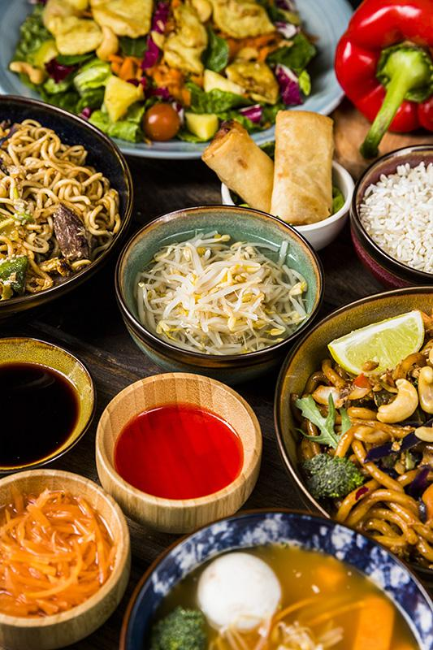
FOODSOU RESTAURANT MANAGEMENT
FPT APTECH - T2208E - SEMESTER 4 - TEAM 3

Slide 2


TEAM MEMBERS
NGUYỄN BẮC GIANG
NGUYỄN HOÀNG NAM
NGUYỄN THANH THỦY
PHẠM QUỐC HOÀNG
NGUYỄN ĐẶNG THÁI SƠN
TRẦN BÙI THÀNH

Slide 3




TABLE OF CONTENTS
01
02
03
INTRODUCTION
PROJECT PLAN
PROJECT IMPLEMENTATION
04
05
06
ACHIEVEMENT
ORIENTED DEVELOPMENT
FAQ

Slide 4

01
INTRODUCTION

Slide 5

OUR
PROJECT
The restaurant chain management project aim to develop a centralized management system for a restaurant chain located in Hanoi. This system will include both web and mobile platforms, streamlining operational processes, order management, delivery services, and customer experience.

Slide 6
GOALS AND OBJECTIVES
Our goals and primary objectives are to build a robust and user-friendly system that enhances operational efficiency, improves customer satisfaction, and supports scalable growth:
Streamline Operations Across Branches
Enhance Order and Delivery Management
Improve Customer Experience
Data-driven Insights for Better Decision-making
Optimize Resource Allocation
Scalable Design for Future Expansion
By achieving these objectives, the FoodSou Restaurant Chain Management Project aims to establish a competitive advantage, ensuring high-quality service, operational excellence, and a seamless experience for both customers and staff across all locations.

Slide 7

02
PROBLEM & SOLUTION

Slide 8
PROBLEM
SOLUTION
Define the problem: Clearly define the issue and put it in context.
Analyze the problem: Understand the issues that need to be addressed.
Determine criteria: Consider what makes an optimal solution.
Propose solutions: Brainstorm and test potential solutions.
Evaluate solutions: Consider the proposed solutions and select one.
Implement the solution: Suggest strategies to put the solution into action.
Monitor results: Track the results to improve performance.
When working on a project, identifying problems and proposing solutions is crucial for its success.

Slide 9
REQUIREMENTS
FUNCTIONAL
NON-FUNCTIONAL
TECHNICAL
User Management
Reservation System
Order Management
Payment Processing
Inventory Management
Performance
Usability
Security
Scalability
Reliability
Front-End Technologies
Back-End Technologies
Database
Hosting

Slide 10

03
PROJECT IMPLEMENTATION

Slide 11
PROJECT ROADMAP - SCHEDULE
Summarize the challenges of managing a multi-branch restaurant chain
Task sheet list detailed tasks for each function to complete, Test-case documentation
Describe the main features of the system with screenshots, showcasing key functionalities.
Describe the problem with diagrams: Stakeholders, Use-case, Flowchart, ERD
Introduction
Plan
Analysis - Design
Supporting Plans
Project Implementation
Technology
Results
Develop a project implementation plan divided into 4 sprints, each lasting 1 week.
Human Resource Plan, Communication Plan, Risk Management Plan
Specify the algorithms and technologies for database management, backend, and frontend development.

Slide 12
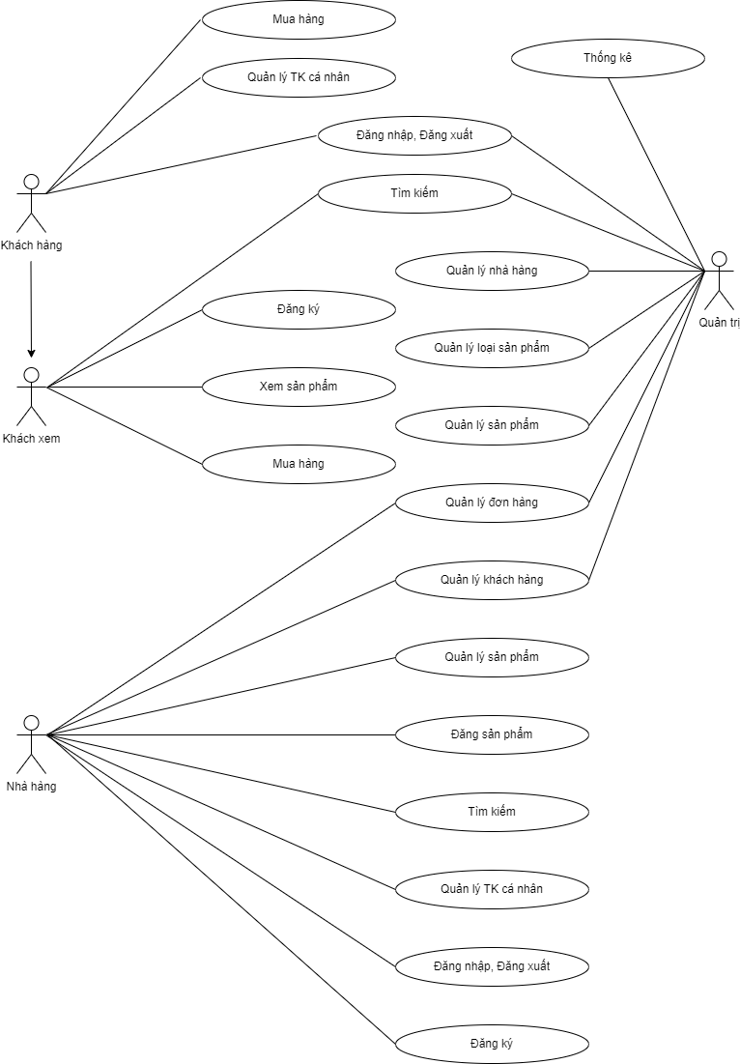
USE CASE
For Customers (Khách hàng)
View Products (Xem sản phẩm):
Manage Personal Account (Quản lý TK cá nhân)
Place Orders (Mua hàng)
Search (Tìm kiếm)
Review Orders (Quản lý đơn hàng)
For Restaurants (Nhà hàng)
Register Products (Đăng sản phẩm)
Manage Product Categories (Quản lý loại sản phẩm)
Manage Orders (Quản lý đơn hàng):
Manage Customer Information (Quản lý khách hàng)
Generate Statistics (Thống kê)
System Administration
User Registration (Đăng ký)
Login (Đăng nhập)

Slide 13
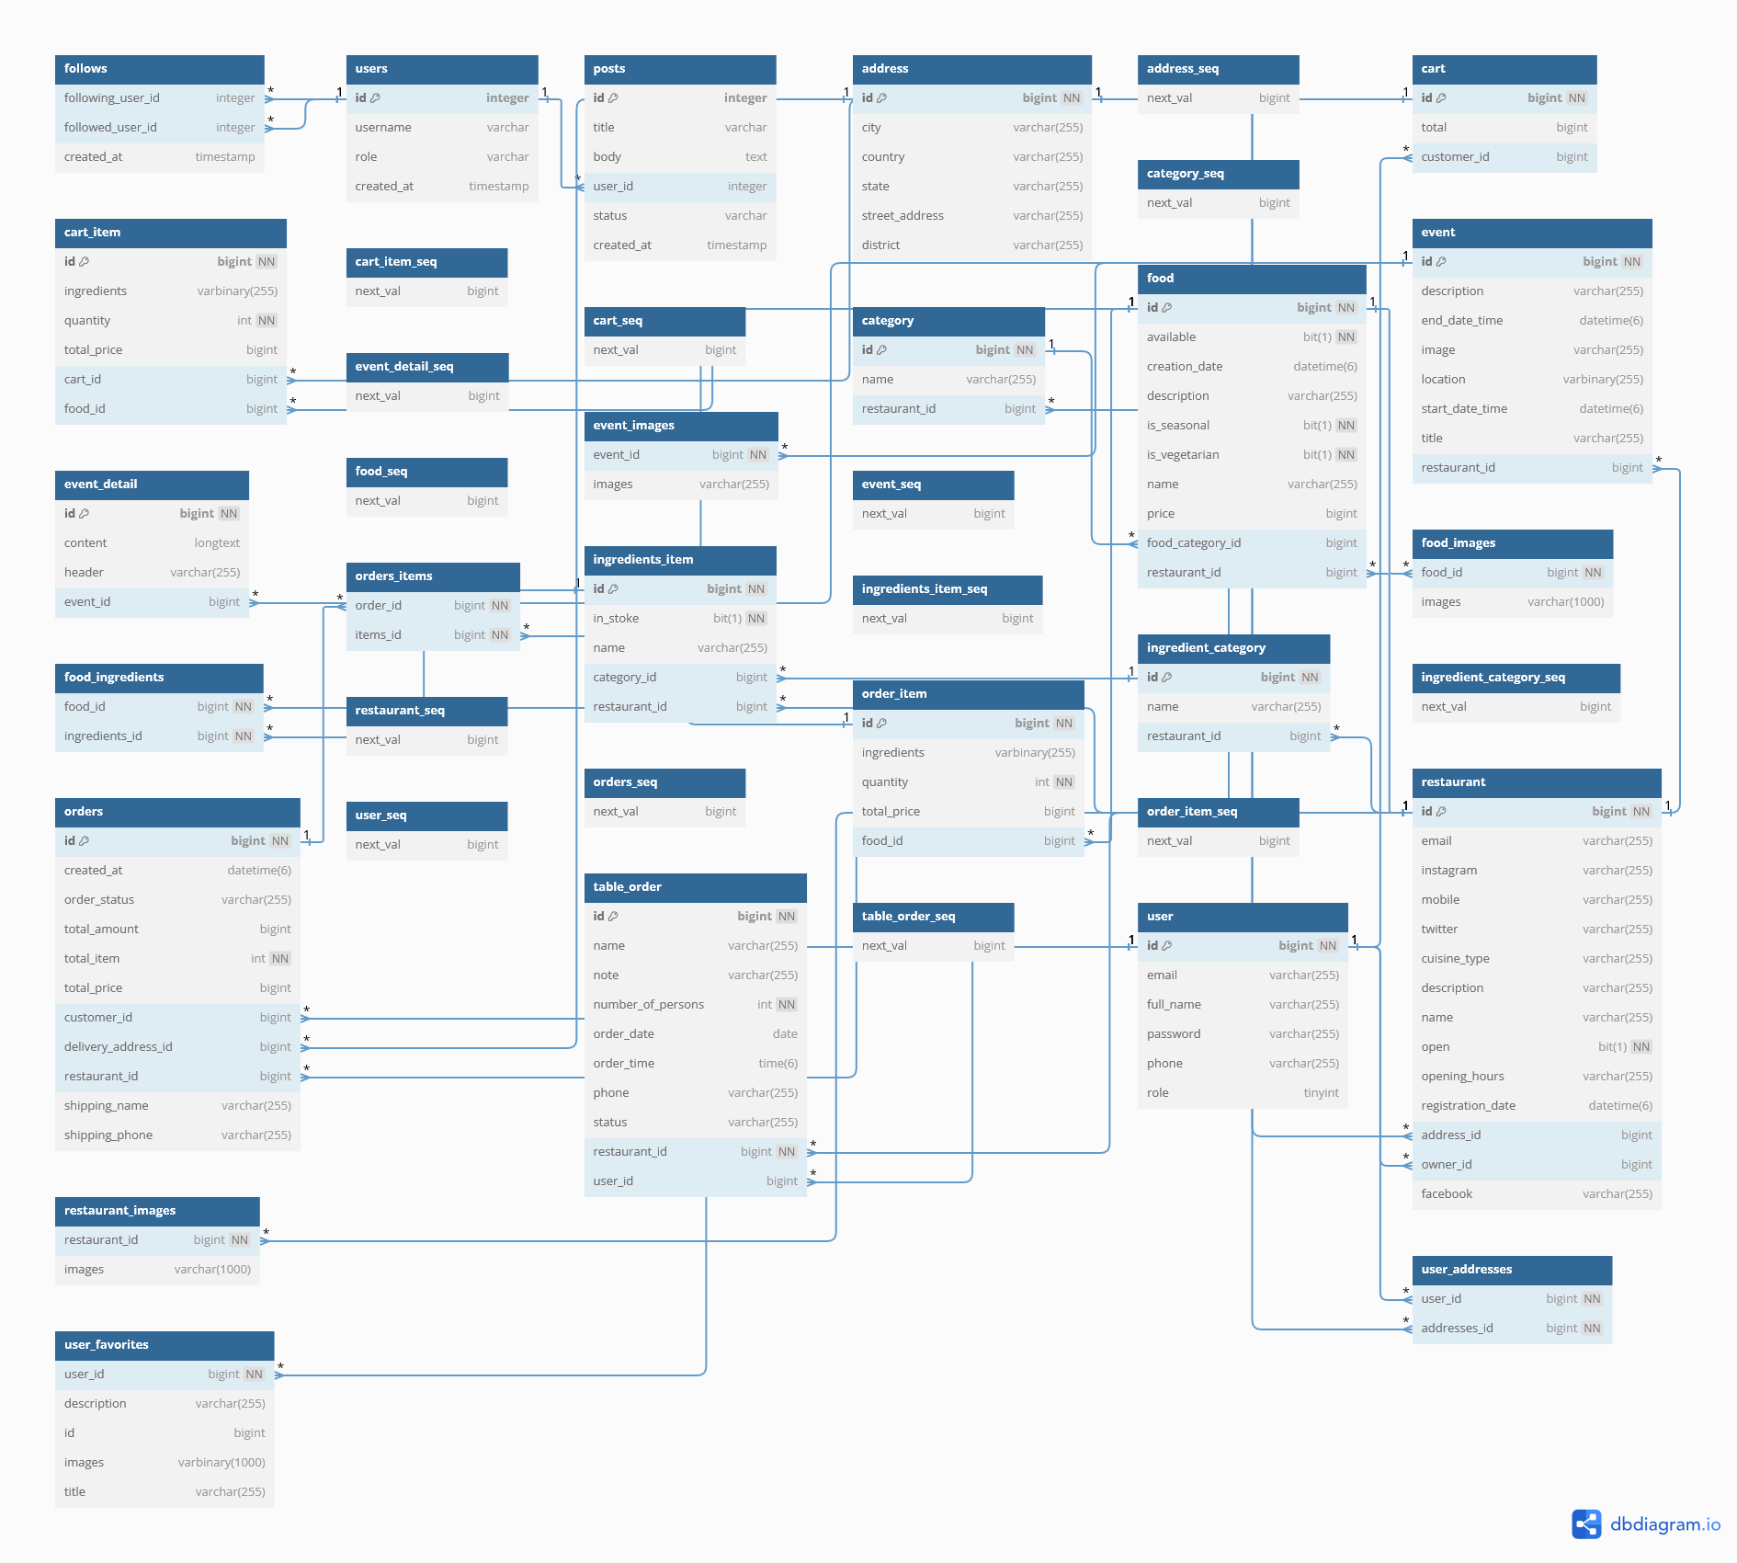
DATABASE DIAGRAM
o users
o restaurants
o address
o category
o food
o ingredients
o menu
o orders
o order_items
o reviews
o favorites
o images

Slide 14
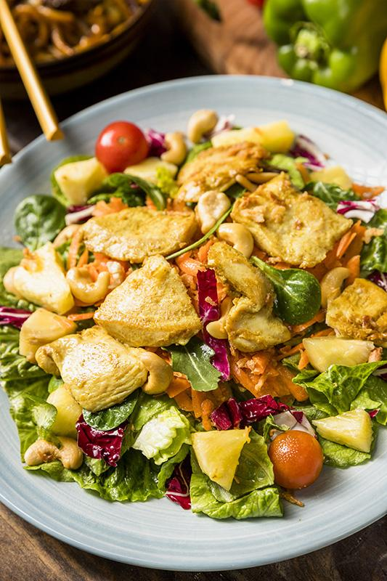
TECHNOLOGY
Front-end React
Back-end Java
Database MySQL
Mobile App Flutter - Dart
Software
Visual Studio Code
MySQL
IntelliJ
Android Studio
Docker
Postman
Jira

Slide 15

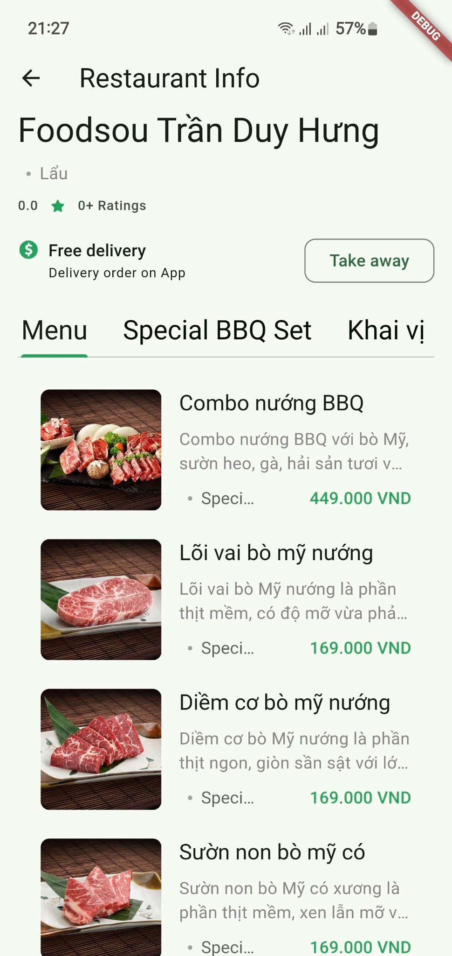
MOBILE APPLICATION
is an essential tool for modern dining, catering to the growing demand for convenience and variety in food delivery.

Slide 16

04
ACHIEVEMENT

Slide 17

OVERVIEW CHECKLIST
WEBSITE FUNCTION
FUNCTIONAL REQUIREMENT
MOBILE APP FUNCTIONAL
NON-FUNCTIONAL REQUIREMENT
TECHNICAL REQUIREMENT

Slide 18

05
ORIENTED DEVELOPMENT

Slide 19
OUR SERVICES
Streamline Operations Across Branches
Enhance Order and Delivery Management
Improve Customer Experience
Data-driven Insights for Better Decision-making
Optimize Resource Allocation
Scalable Design for Future Expansion

Slide 20
MARKET SIZE
IN THE FUTURE
FROM
Hanoi
TO
All over the world

Slide 21
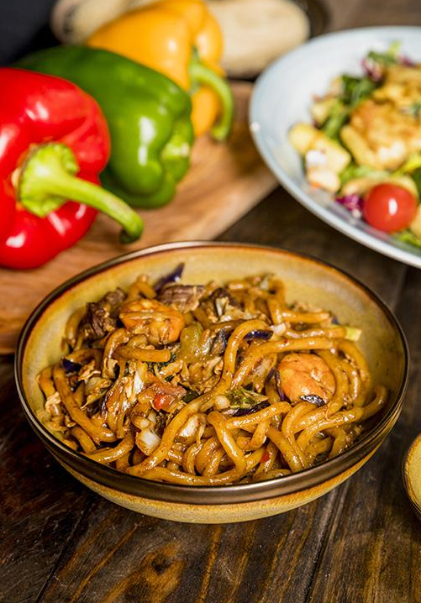
06
FAQ

Slide 22
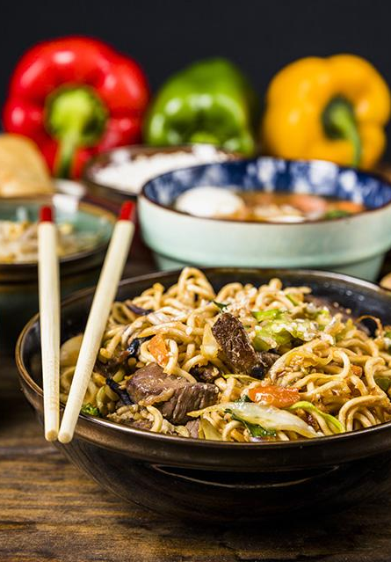
THANKS FOR YOUR WATCHING AND LISTENING.

